Slide 1
Workshop: Young people against drugs: Capturing and promotion resilience using photo-voice
Event: Youth Wellness Festival, Yuva-Mann-Meet
Date: 09.11.2019
Time: 11AM- 12:30PM and 2PM- 3:30PM
Venue: Lokpriya Gopinath Bordoloi Regional Institute of Mental Health, Tezpur
Number of participants attended (in total): 30
Funders: ESRC, AHRC
Grant Number: ES/S00047X/1

Slide 2
By
Dr. Raginie Duara
Research Fellow, University of Leeds

Slide 3
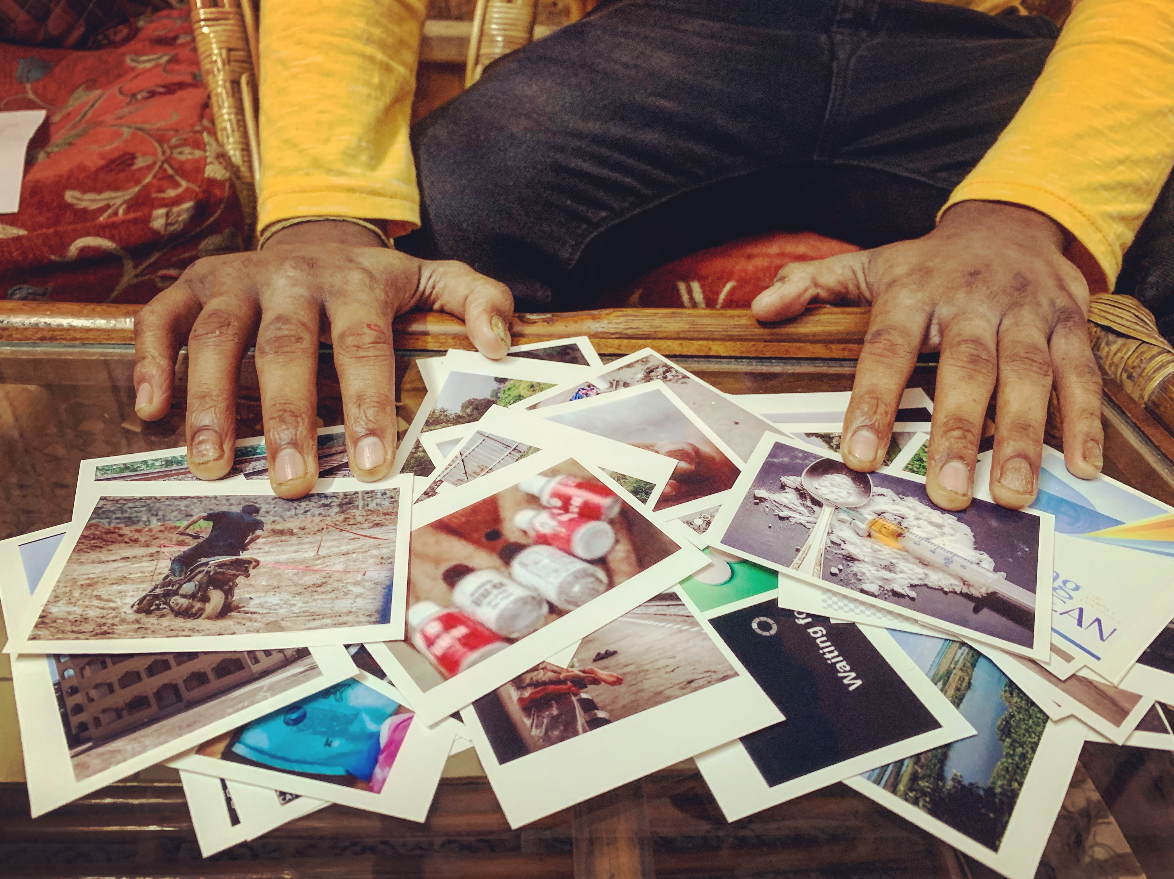
Photo-led interviews
Successfully resisting drug addiction
Successfully recovered from drug addiction

Slide 4
Contacted by our Partner Organizations directly
Nirmaan Rehabilitation Facility
First meeting with the researcher
Complete information about the study
Period of 2 weeks to collect photos/images
Guidance taken from researcher if needed
HOPE Foundation
MIND India
Taking consent
Second meeting with the researcher
Discussing the photos/images brought
Sharing their story of resistance/recovery

Slide 5
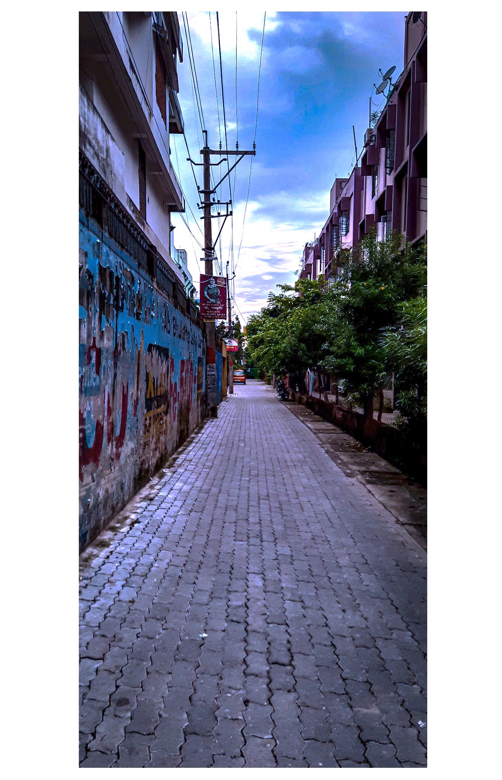
Photo 4
Photo 5
“More natural...yeah. And this (referring to photo 4)...there are people who they are going to sweep it... just imagine this to be memories. And you... while... when you are on drugs... you just like tend to sweep it but it will come back every morning... you can’t escape from it. But this (photo 5)... unless and until you know how to deal it... like this...if you like... to be more specific... like... I want to like… what I want to say is that... this grey area... like if you like give some time... they will cover up your space.” (Samba, M, 18 years)

Slide 6
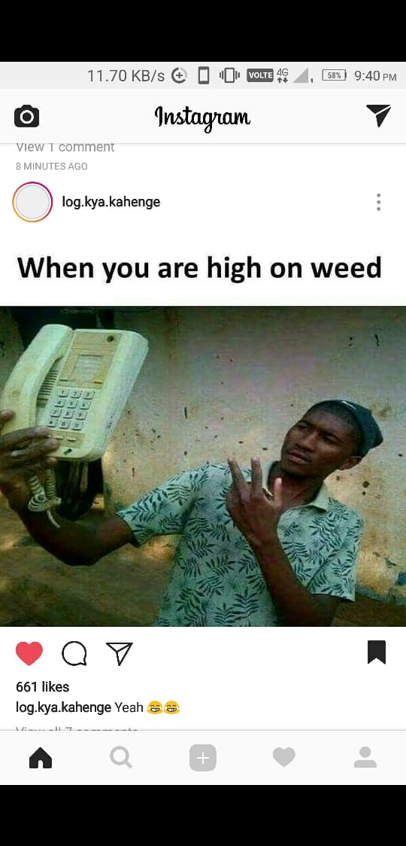
“The, the memes where you get to see things that you would kind of want to do, or want to try.
and then there is also uh, uh you know people who you look up to like […] actually in broader sense it was my parents […] but later on it was my…my like, I also wanted to avoid because...now I am eighteen. At that moment, like in class eight, I was just fourteen years old. […] I didn’t even know what was good, what was right. […] so for that, so for the next three years, almost till the age of sixteen because of my parents I was not taking up anything. But from the age of seventeen I understood it’s not good, like there is more to life. So from, from the age of seventeen, I myself I used to reject…” (Rohan, M, 18 years)

Slide 7
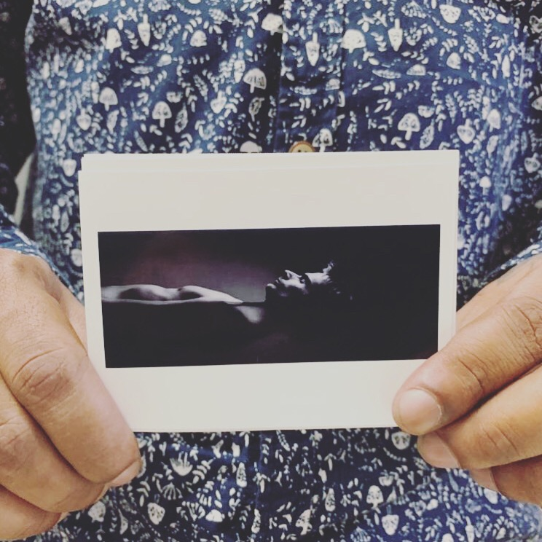
So it was like I was getting grinded in the middle. And my mom, she wanted me to do something else. My dad, he wanted me to do something else but when I needed them I never got them. So it was like that. So for all these things I, I was like I really didn’t want to face all these things. I wanted to means, be in my own world. And at that time the best option for me was getting high. Because norm- “NS” means if I had been normal at that time I didn’t…I really wouldn’t have known how to face it. So it was like its better my eyes are shut, I don’t see anything, I stay isolated. So err, at that time my thinking was like that, and so I tried to isolate myself from everyone in that way only, by staying high and not facing the reality (pointing to photo 4).
Now after getting clean I am starting to learn small, small things no. Because at that time I was seeing all these things, I was trying to run away from life; I didn’t want to face it, I got hooked to drugs in a small age, and I didn’t know the basic facts of life only. But now slowly, slowly…now I am trying to learn no, by getting joy, by doing the small things, like you know, like greeting someone nicely. Because at that time I was..not me, I was trying to be someone else who is as hard as a rock, who does not have any feelings and all. (James, M, 24 years)
Photo 4

Slide 8
Photo 5
Condition was bad means my health was completely deteriorated ok and means it happened like I’m sitting somewhere. Nothing seems to please me. Completely blank. I had a photo of that time. Where is it, let me describe it. This one (refers to photo 5). If I sit somewhere, I couldn’t see anything. I felt life there’s nothing in my life. Because I was actually doing nothing. I just wake up in the morning, get intoxicated, sleep at night. Get intoxicated till my eyes aren’t closed and then sleep. (Manav, M, 24 years)

Slide 9
Thank you

